Slide 1

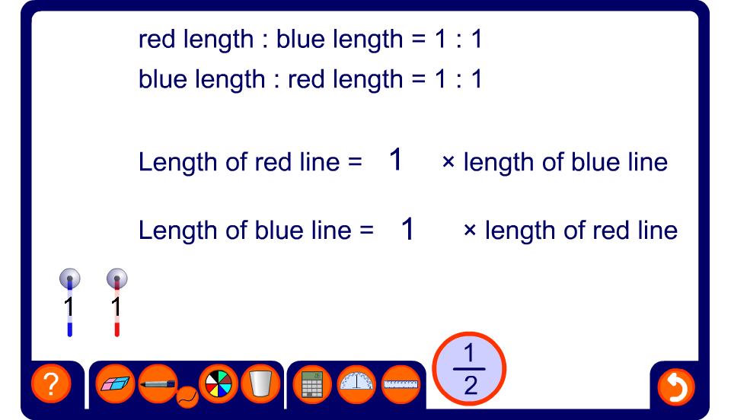


Comparing lengths of line segments
Notes:
We use ratio to compare two quantities to each other.
Use this activity to revise the concept of ratio and ratio notation. The activity also shows ratios as fraction, decimal and percentage multipliers.
In the case of these lines segments we can compare the length of the red line to the length of the blue line or the length of the blue line to the length of the red line.
Vary the lengths of red and blue lines to demonstrate a variety of ratios.
Explore equivalent ratios by doubling the length of both lines, for example, and observing that the ratios remain unchanged.
Explain that ratios can also be given as fractions and decimals (and less often as percentages). Establish that the number that multiplies the length of the red line to give the length of the blue line will always be the reciprocal of the number that multiplies the length of the blue line to give the length of the red line (and vice versa).
Use the lines to give specific ratio problems. For example, set the red line to 5 units and ask a volunteer to change the length of the blue line so that the ratio of the red length to the blue length is 2 : 1.

